Slide 1




MS 491-I Product Management
BUSINESS PROPOSAL
yourstory.com

Slide 2



Events and conferences
Newsletter
Who are we?
YourStory provides a platform for entrepreneurs to share their experiences, challenges, and successes, and it also covers news and trends in the startup world.
Videos and Podcast
Articles and Features

Slide 3

What do we offer?
01
Visibility and recognition for startups
02
Inspiration and motivation
03
Information and education

Slide 4
What do we offer?
04
Market awareness and trends
Connecting entrepreneurs with
resources
05
06
Networking and community building

Slide 5





Target Audience
Entrepreneurs
Investors
Educational Institutions
It caters to individuals who are actively engaged in starting and running their own businesses. This could range from early-stage startups to more established companies
YourStory's content is of interest to venture capitalists, angel investors, and other types of investors looking for potential investment opportunities.
It's content is valuable for students, faculty, and administrators at universities and business schools with an interest in entrepreneurship and startups.

Slide 6




USER JOURNEY
Envision the journey of a user in the target market
Discovery and onboarding
User registration and profile setup.
Content consumption and exploration
When: An aspiring entrepreneur hears about YourStory through word-of-mouth, social media, or a search engine.
How: They visit the website.
Why: They are looking for inspiration, resources, and information.
When: Upon their first visit.
How: They create a user account, providing basic information and setting preferences.
Why: To personalize their experience, and receive tailored content.
When: During their free time, breaks, or whenever they seek inspiration.
How: They browse through articles, watch videos, listen to podcasts, etc.
Why: To gain insights, and learn from success stories.

Slide 7

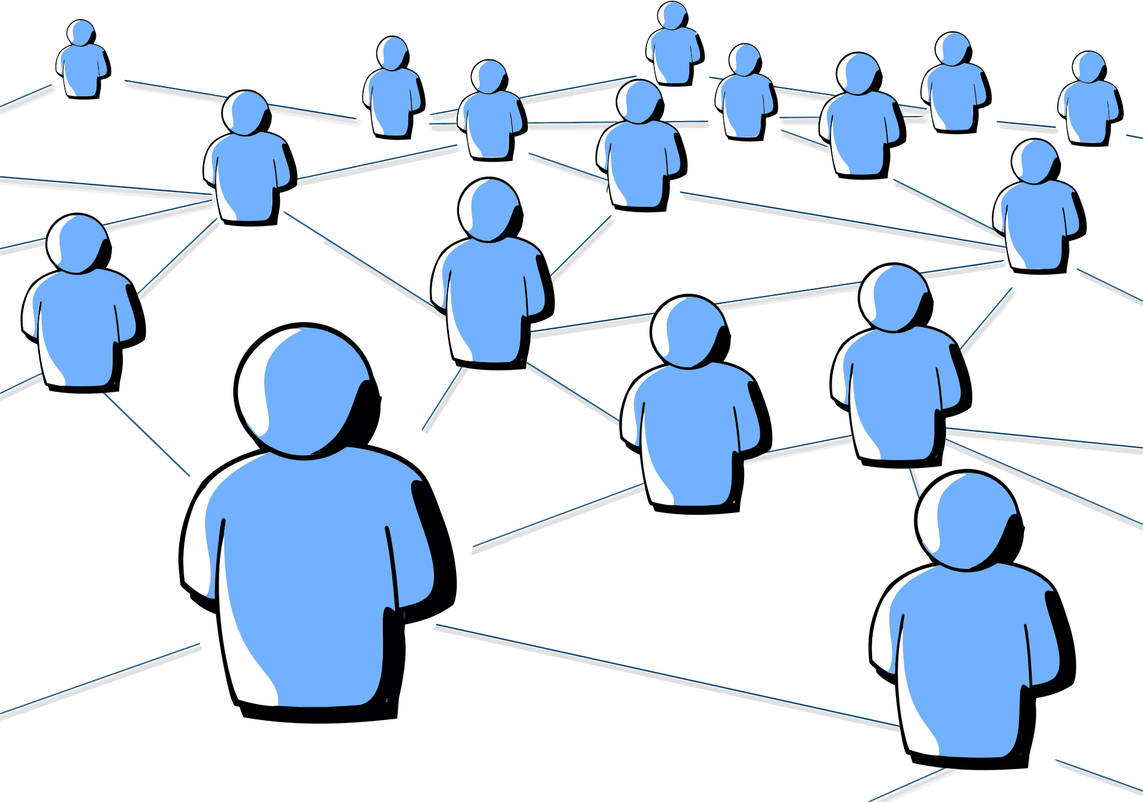

USER JOURNEY
Envision the journey of a user in the target market
Startup discovery and research
Engagement with the community
Event paticipation
When: When they're actively looking for new startup ideas or researching specific industries. How: They use the search and filtering options to discover startups.
Why: To learn from existing startups, or find investment.
When: Regularly, as part of their networking and learning routine. How: They participate in forums, join groups, and attend virtual events.
Why: To connect with like-minded individuals, and seek advice.
When: When there's an event of interest happening in their region or industry.
How: They check the event listings, register, and attend (either physically or virtually). Why: To gain knowledge, and discover new opportunities

Slide 8



USER JOURNEY
Envision the journey of a user in the target market
Utilizing tools and resources
Staying updated with real-time news
Providing feedback and engaging with analytics
When: When they're in the early stages of planning or executing their startup.
How: They access and use tools like business planning templates or financial calculators.
Why: To get practical guidance, streamline their processes, and make informed decisions.
When: Daily or as frequently as they prefer.
How: They check the latest news and updates on the platform.
Why: To stay informed about industry trends, market shifts, and emerging technologies.
When: As and when they have suggestions or observations. How: They use the feedback feature or engage with the analytics dashboard.
Why: To contribute to product improvement and see how their engagement benefits them.

Slide 9








Optimized Search Engine for Startups
Personalized User Profiles
Monetization Strategy
Event Integration
Community and
Networking Features
Startup Success Stories and
Case Studies

Slide 10






Content Curation and Recommendation
Feedback and Analytics Dashboard
User Friendly Web/App
Market Research Reports
Funding Opportunity
Resource Directory

Slide 11

Product Requirement | Dev/Tech Feasibilty | Effort Estimate | Customer Willingness to Pay | Differentiation | Scale
Personalized User Profiles | Yes | Low | High | Medium | High
Content Curation and Recommendation | Yes | Medium | High | High | High
Startup Database and Search Functionality | Yes | High | High | High | High
Event Integration | Yes | Medium | High | Medium | Medium
Community and Networking Features | Yes | High | High | High | High
Resource Directory | Yes | High | High | High | Low
In-Depth Industry Reports and Analysis | Yes | High | High | High | Low

Slide 12
Product Requirments | Reach (new customers / quarter) | Impact (scale of 0.25-3) | Confidence(%) | Effort (hours each person / month) | RICE Score
Personalized User Profiles | 1000 | 2 | 50 | 5 | 200
Content Curation and Recommendation | 1000 | 1 | 75 | 8 | 93.75
Startup Database and Search Functionality | 500 | 1 | 50 | 7 | 35.71
Event Integration | 100 | 3 | 25 | 11 | 6.82
Community and Networking Features | 5000 | 1 | 100 | 10 | 500
Resource Directory | 50 | 3 | 75 | 12 | 9.375
In-Depth Industry Reports and Analysis | 10 | 3 | 100 | 10 | 3

Slide 13

THANK YOU
Meet Hariyani - 21110072
Kevin Shah - 20110096
Priya Gupta - 20110147

